Slide 1
International Student House
Alice is a good worker and colleague
Liling Chen

Slide 2
Market Research – Long term rent
Accommodation cost
A double bed ensuit in student accommodation for 51 weeks is
£135*51=£6885
A double bed ensuit in private house for 51 weeks is
£95 (maximum price)*51=£4845
Students can save £2040 per year.
The money they save from accommodation means they have more spendable money to pay courses provided by University (such as 6 week pre-session English course).
Lower accommodation price would encourage them to study long time course such as 3 year undergraduate course or 3 year doctoral course.

Slide 3
Market Research - Long term rent
Questionnaire Summary (Appendix One)
7 out of 9 students would like to live in private house.
Among 7 people who would like to live in private house, only 2 people chose private house.
The major reasons are they don’t have access to UK house renting information when they have not arrived UK, they have safe and security concern about living at private house and there s no platform to secure the payment transaction.

Slide 4
Market Research – Summer Short term rent
There is only one student accommodation available in Liverpool for summer short term rent. Price is fixed £125 per week. Only single bed ensuit available.
The average short term in House is £80 per week. There is not platform for international student to book.
Savings
For 6 weeks English session: (125-80)*6=£270 (equals to one month food expenses)

Slide 5
Market Research – September Short term
Master students have to find one month short-term lets to finish their study from 1 September to 30 September.
No student accommodation can offer short term during this time. There is almost no landlord will offer one-month rent.
Living in hotels for a month will cost about £1000.
The normal rental price for a month is £400.

Slide 6
Competitors research
Chinese estate agent are not likely to provide private house student renting services. They are not based in the UK. . They won’t be able to manage the UK local properties. They can’t provide instant service to Chinese students in the UK.
UK estate agents are less likely to provide service international students as they are locally based.

Slide 7
Marketing plan – Product/Service
1. Long term rent for undergraduate and postgraduate students
Qualified private house and specialised service for international students.
The properties we advise will meet the standards set up by Liverpool Student Home (LSH).
2. Summer Short term rent for pre-sessional English course students
Qualified private house
Homestay
Luxury apartment
3. September Short term rent for student doing master degree
Have long term relationship with providers who can provide short term rent during September every year.

Slide 8
Marketing plan - Pricing
1. Long term let
Price is decided by individual landlords. Price will start from £60 per week.
2. Summer short term let
Price starts from £80 per week.
3. September short term let
Price will be more expensive than normal weekly rent but cheaper than hotel
Average price –
£120 per week for house
£200 per week for apartment

Slide 9
Marketing plan - Promotion
Word of Mouth – recommendation
Social Media – wechat , Chinese student forum
Website – regular updates & featured house
Agents in China – recommend the website to students who are coming to UK to study.

Slide 10
Marketing plan – People and Place
People
I will be responsible to all aspects of the business as a sole trader. I will pay for the IT service e.g. website developing and maintenance on a consultancy basis. As the business develops I will take on additional staff to support customer service.
Place
I will be operating the business from home initially. I am looking to have a virtual office service at Women’s organisation or have a hot desk provided by University.

Slide 11
Financial Plan - Start up cost
Laptop, printer
Website development
Business insurance
Advertising
Legal service fee
Please refer to cash flow for more information

Slide 12
Financial Plan - Projected sales for 2017
Scale of students – Chinese students studying at Liverpool Universities
 | No. of tenants | No. of landlords | Price | Turnover
Summer short term let | 20 | 4 | 50 | 20*50+4*50=£1200
September short term let | 30 | - | 50 | 30*50=£1500
Long term let | 30 | 6 | 200 , 100 | 30*200+6*100=£6600
Visitors studying short term course | 10 | 2 | 200 , 100 | 10*200+2*100=£2200
Total | 90 | 12 | - | £11,500
The projected sales would be £103,500 (£11,500*9) if services include other major cities London, Manchester, Birmingham, Glasgow, Edinburgh, Sheffield, Nottingham, Coventry and Liverpool.

Slide 13



Future development – study one month course during travelling the UK
From 1 Oct 2013, visitor visa holders can study up to 30 days course. Courses can be sailing, the British court costumes tailor training, sports motorcycle driver’s license training and other lifestyle courses. This suits Chinese professionals who want to learn advanced skills which might not be original in China.
There are about 150 million Chinese coming to visit UK in 2015. The number increases about 74% than the number in 2014.
There is no company providing courses information as well as reliable source of accommodation for a month.

Slide 14
Appendix One - Questionnaire ：Do you prefer living at Student Accommodation or Houses in your first year? Why?
9 Master Students | Gender | Where did you live in your first year | Reason | Would you like to live in Private House | Reason | Reason for not choose house as your first choice
东哥 | Male | Student Accommodation | Internet Agent | Yes | Same as student accommodation Cheaper price | Don’t have information about house Don’t trust private landlords Potential Disputes
适 | Male | Private House | Friend Recommendation | Yes | Same as student accommodation Cheaper price | x
Rolando （Mexico） | Male | Student Accommodation | Internet Agent | Yes | Same as student accommodation Cheaper price | Don’t have information about house Don’t trust private landlords Payment security
Jules （Congo） | Male | Student Accommodation | Internet Agent | Yes | Same as student accommodation Cheaper price | Don’t have information about house Don’t know who is going to live with
张记 | Male | Private House | Friend Recommendation | Yes | Cheaper price | x
Project Man A （Nigeria） | Male | Student Accommodation | Internet Agent | Yes | More relax Cheaper price | Don’t have information about house Payment security
临 | Female | Student Accommodation | Internet Agent | No | Don’t need to share bathroom | x
茹 | Female | Student Accommodation | Internet Agent | No | Have security guard Safer | x
玉菡 | Female | Student Accommodation | Internet Agent | Yes | Cheaper | Don’t have information about house Don’t know who is going to live with

Slide 15
Appendix Two – Pre-sessional English course fee
Pre-sessional English | Course dates | Fee
10 weeks | 04/07/16 - 09/09/16 | £2,900
6 weeks | 01/08/16 - 09/09/16 | £1,740

Slide 16

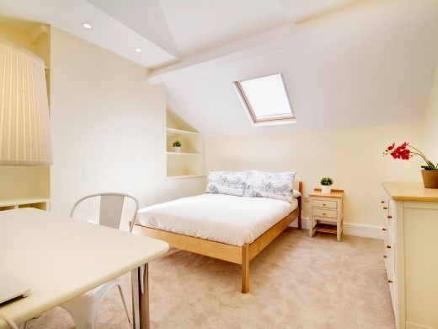







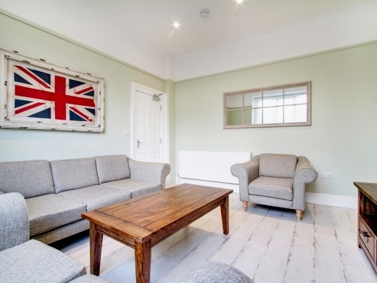
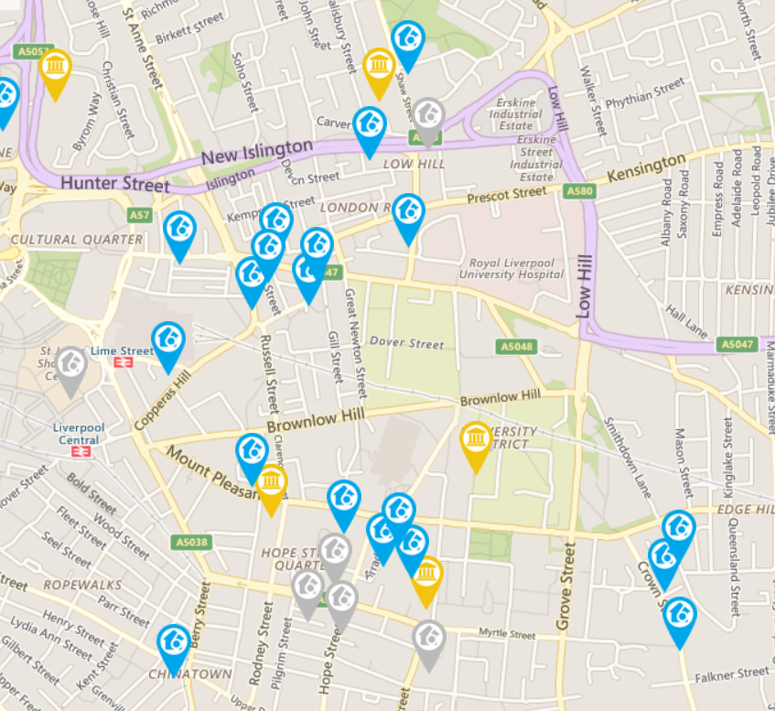

Log in Sign up
International Student House
Short term · Long term · Leisure
Price Recommend Map view Roommate waiting
£95/week
4.5
Education background, subject, years of renting
2 roommate waiting
Safety
Chat
Distance
Maintenance
Service
Customer review
Thank you!
It is a great place to live!

